Slide 1

Xamarin: Moving On
Mike Irving – Microsoft MVP
Senior Developer – Blue Beck
Dot NET Liverpool – 12th November 2024
@mikeirvingweb

Slide 2

Mike Irving – Microsoft MVP
Co-organizer of Dot Net North and Macc Tech
X / Twitter - twitter.com/mikeirvingweb
LinkedIn - linkedin.com/in/mikeirving
GitHub - github.com/mikeirvingweb
Stack Overflow - stackoverflow.com/users/482901/mike-irving
Website & Blog - mike-irving.co.uk

Slide 3
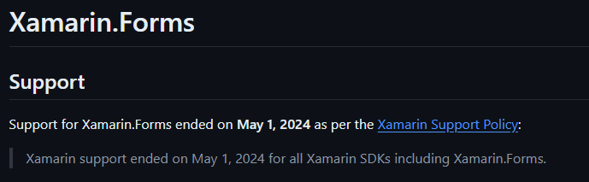
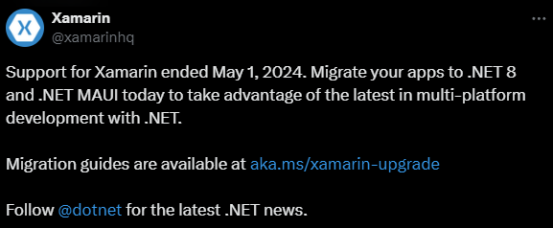

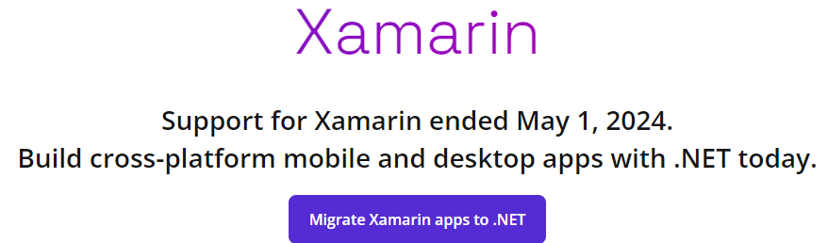
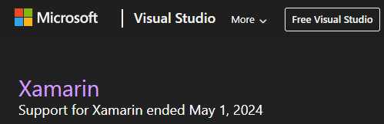

Slide 4
What was Xamarin?
Lots of things..
Native Apps offerings:
- Xamarin.iOS (MonoTouch)
- Xamarin.Android (MonoDroid)
- Windows and macOS (later)
Portable Class Libraries (PCL)
Xamarin Studio (MonoDevelop) IDE
Xamarin.Forms (cross platform offering)
Tools and Services

Slide 5

Mono Runtime
Open Source .NET Runtime
Allows .NET to run on Linux
Founded in 2004
Convergence started with .NET Core in .NET 5
“Unification” by .NET 6

Slide 6
History
2000
2001
2002
2003
2004
2005
2006
2007
2008
2009
2010
2011
2012
2013
2014
2015
2016
2017
2018
2019
2020
2021
2022
2023
2024
2025
Where did things begin?

Slide 7
2000
2001
2002
2003
2004
2005
2006
2007
2008
2009
2010
2011
2012
2013
2014
2015
2016
2017
2018
2019
2020
2021
2022
2023
2024
2025

Slide 8
2000
2001
2002
2003
2004
2005
2006
2007
2008
2009
2010
2011
2012
2013
2014
2015
2016
2017
2018
2019
2020
2021
2022
2023
2024
2025

Slide 9
2000
2001
2002
2003
2004
2005
2006
2007
2008
2009
2010
2011
2012
2013
2014
2015
2016
2017
2018
2019
2020
2021
2022
2023
2024
2025

Slide 10
2000
2001
2002
2003
2004
2005
2006
2007
2008
2009
2010
2011
2012
2013
2014
2015
2016
2017
2018
2019
2020
2021
2022
2023
2024
2025

Slide 11
2000
2001
2002
2003
2004
2005
2006
2007
2008
2009
2010
2011
2012
2013
2014
2015
2016
2017
2018
2019
2020
2021
2022
2023
2024
2025
MonoTouch
‘Xamarin’
MonoDroid

Slide 12
2000
2001
2002
2003
2004
2005
2006
2007
2008
2009
2010
2011
2012
2013
2014
2015
2016
2017
2018
2019
2020
2021
2022
2023
2024
2025
Xamarin.iOS
‘Xamarin’
Xamarin.Android
Xamarin Studio (macOS) + plugins for Visual Studio (Windows)
Portable Class Libraries (PCL)
+ macOS, tvOS,
watchOS, Windows

Slide 13

1st Party Native
iOS
Android
Windows
Objective-C/Swift
Xcode
Java/Kotlin
Android Studio
C#
Visual Studio
No shared code • Many languages and development environments • Multiple teams

Slide 14
Xamarin’s unique approach
iOS UI
Android UI
Windows UI
Shared C# Logic
Shared C# codebase • 100% native API access • High performance

Slide 15




Xamarin
iOS UI
Android UI
Windows UI
Shared C# Logic
3 Native User Interfaces
Shared App Logic

Slide 16
Everything you can do
in Objective-C, Swift, Java or Kotlin
can be done in C# with Xamarin

Slide 17
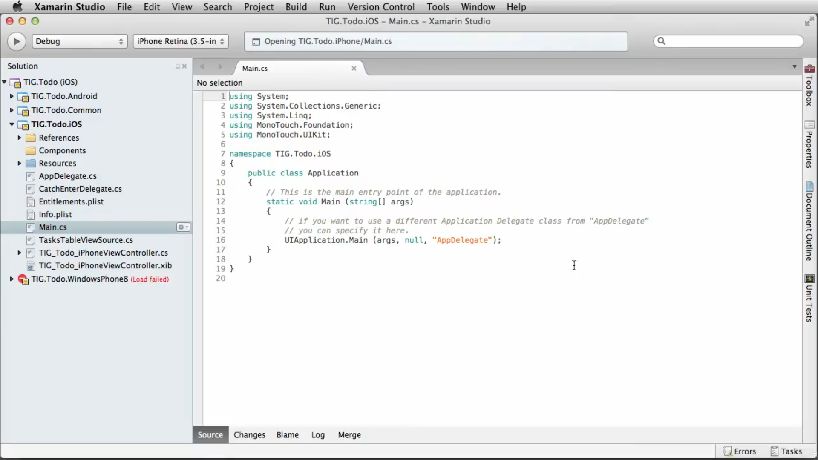
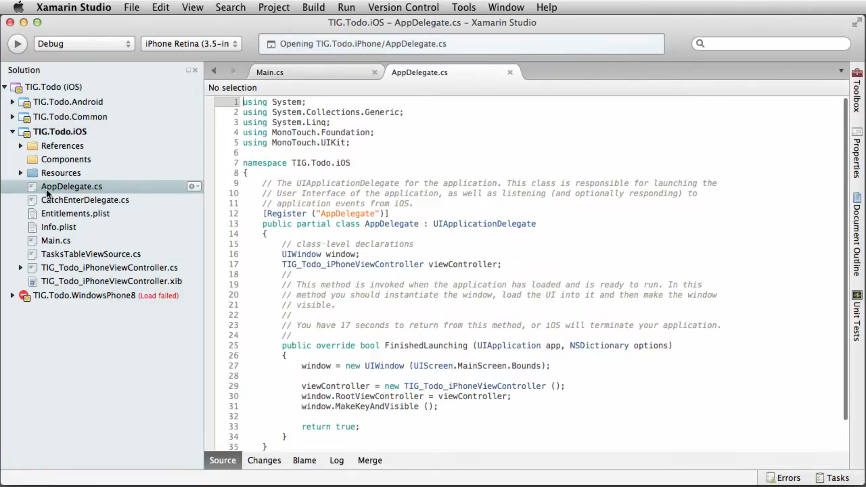
Xamarin.iOS

Slide 18
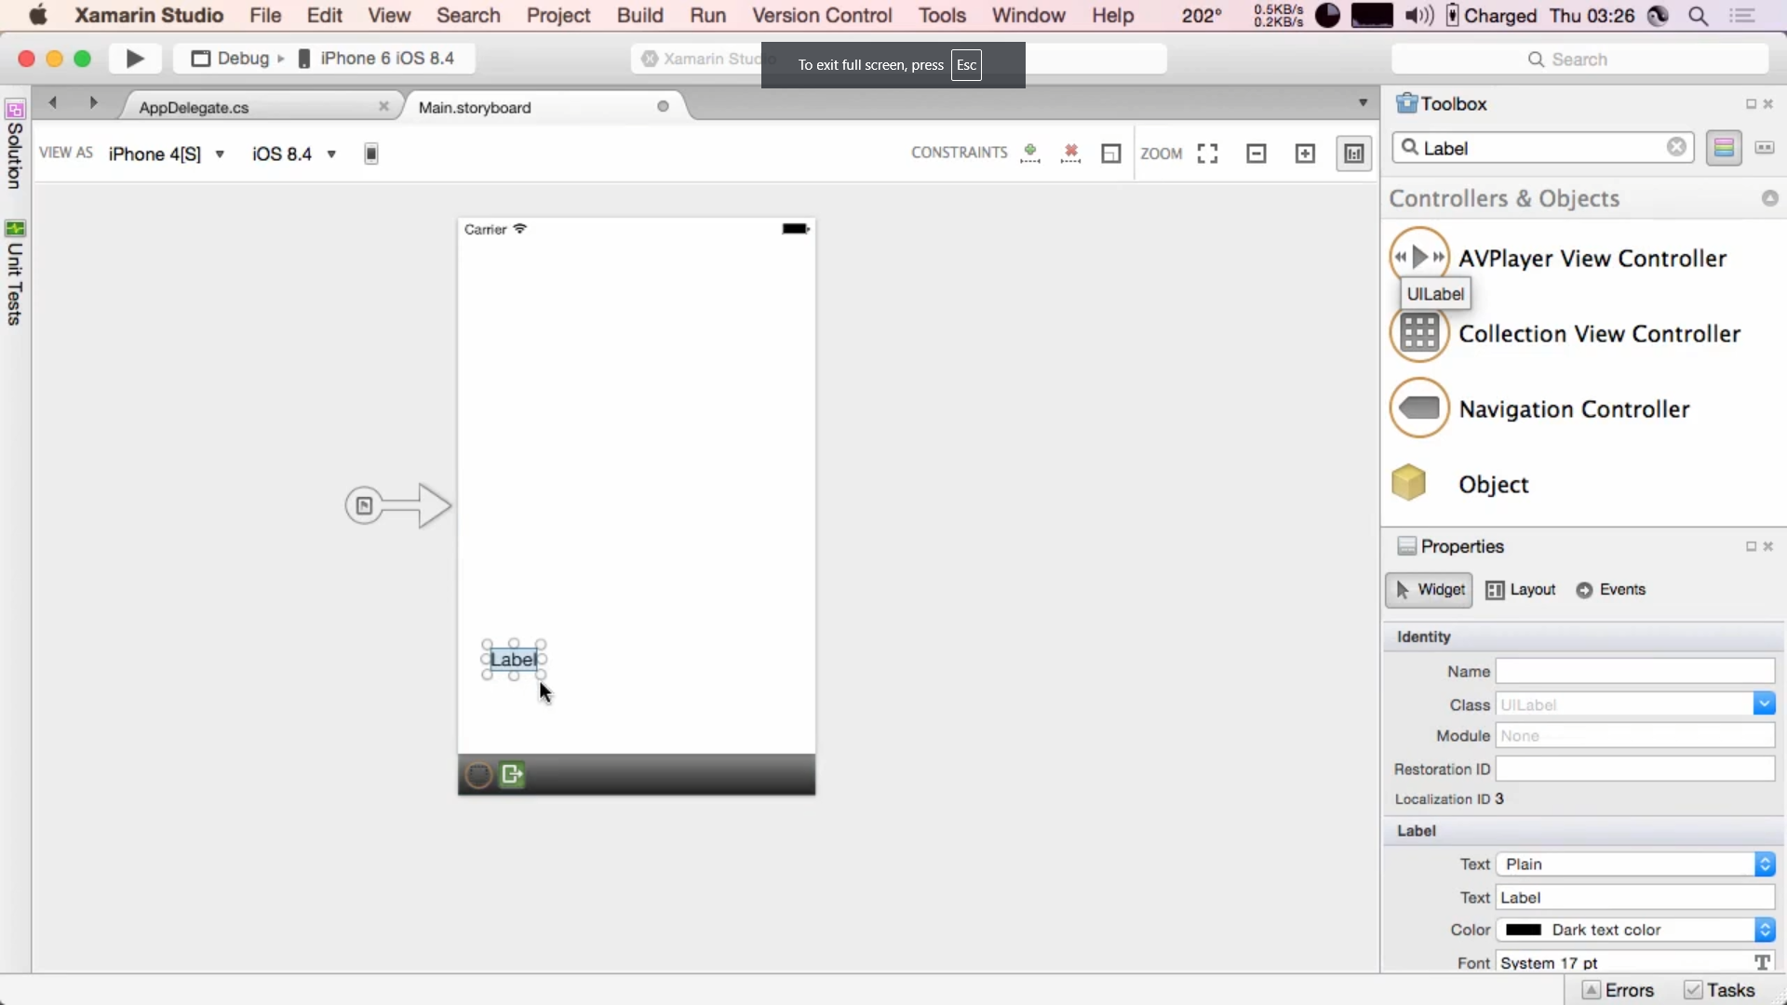
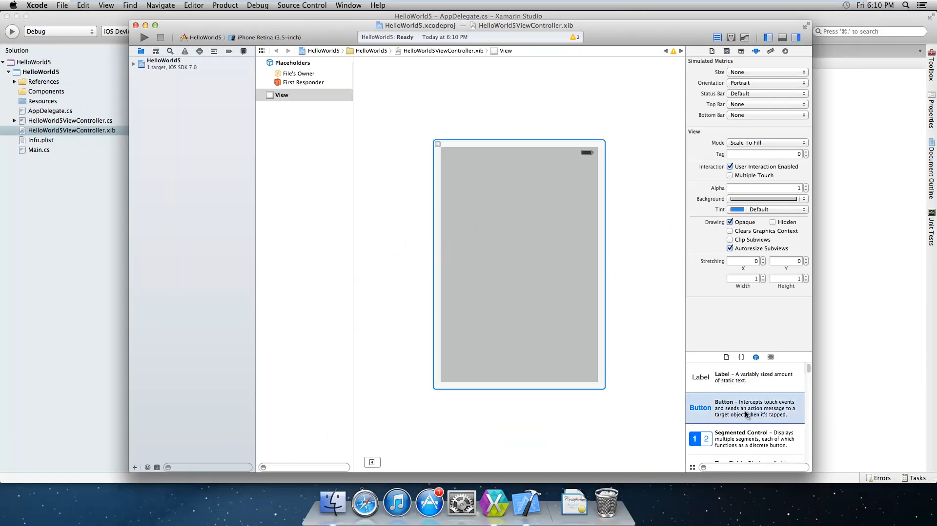
Xamarin.iOS – Interface Builder

Slide 19
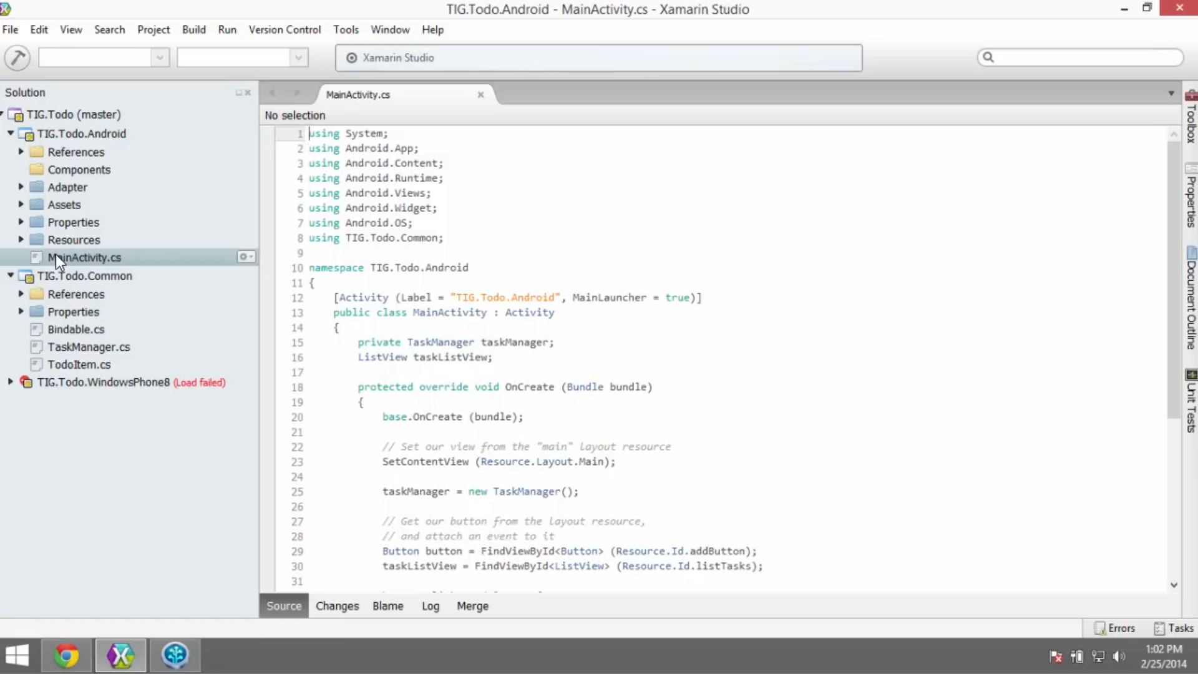
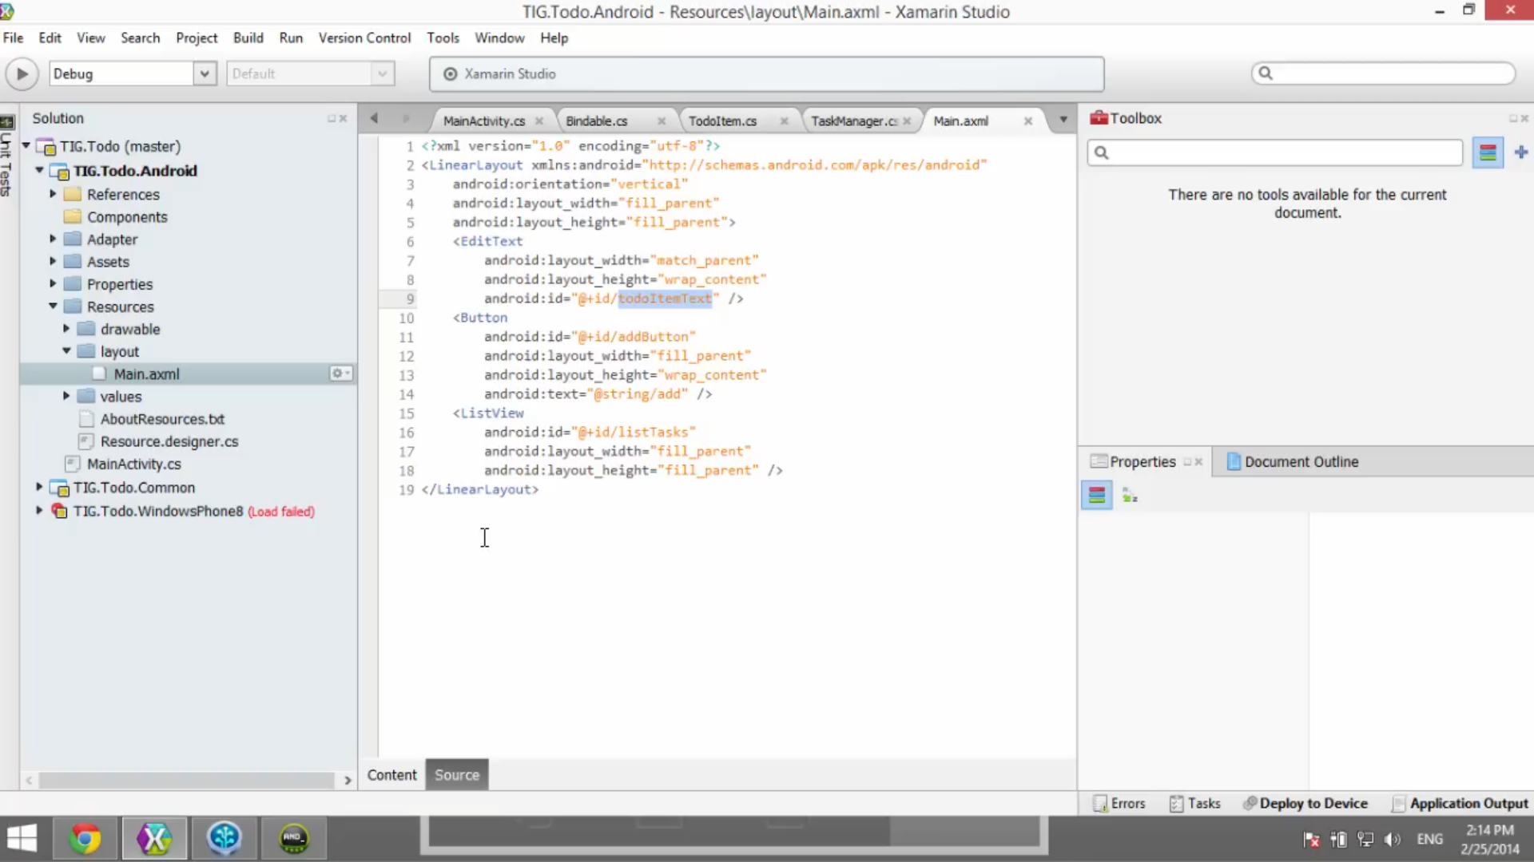
Xamarin.Android

Slide 20
Xamarin Native
Advantages
Disadvantages
Use C# instead of Obj-C or Java
Full native API / SDK reach
Fast
Visual Studio (or Xamarin Studio)
Not fully Cross-Platform
- not write once, run everywhere
Relied on Xcode Interface Builder (iOS)
iOS dev only with a Mac (initially)

Slide 21

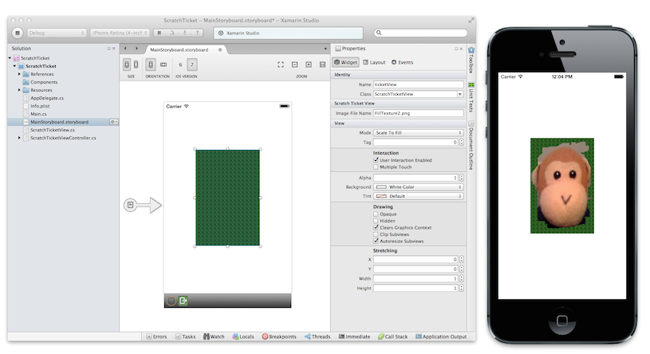
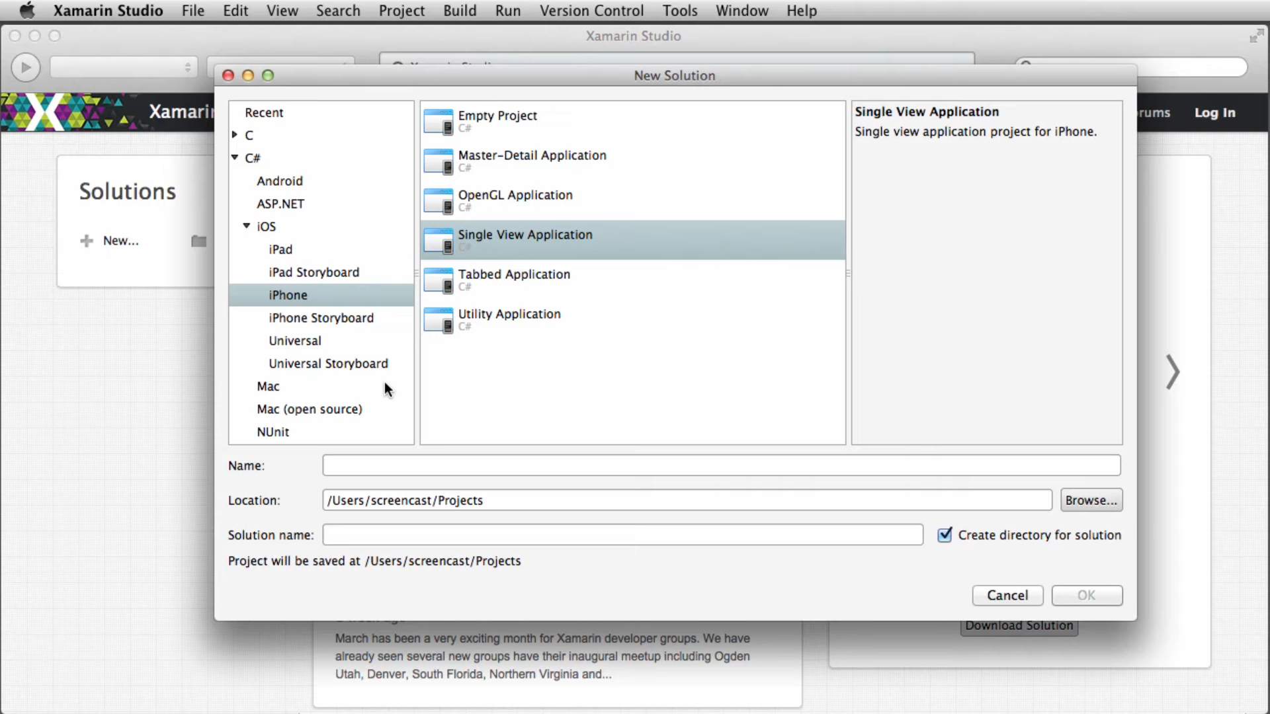
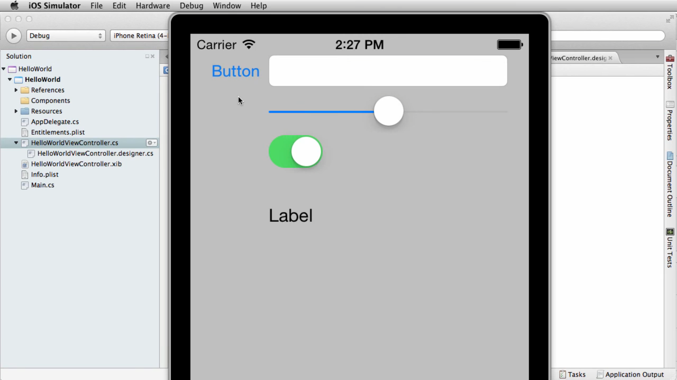
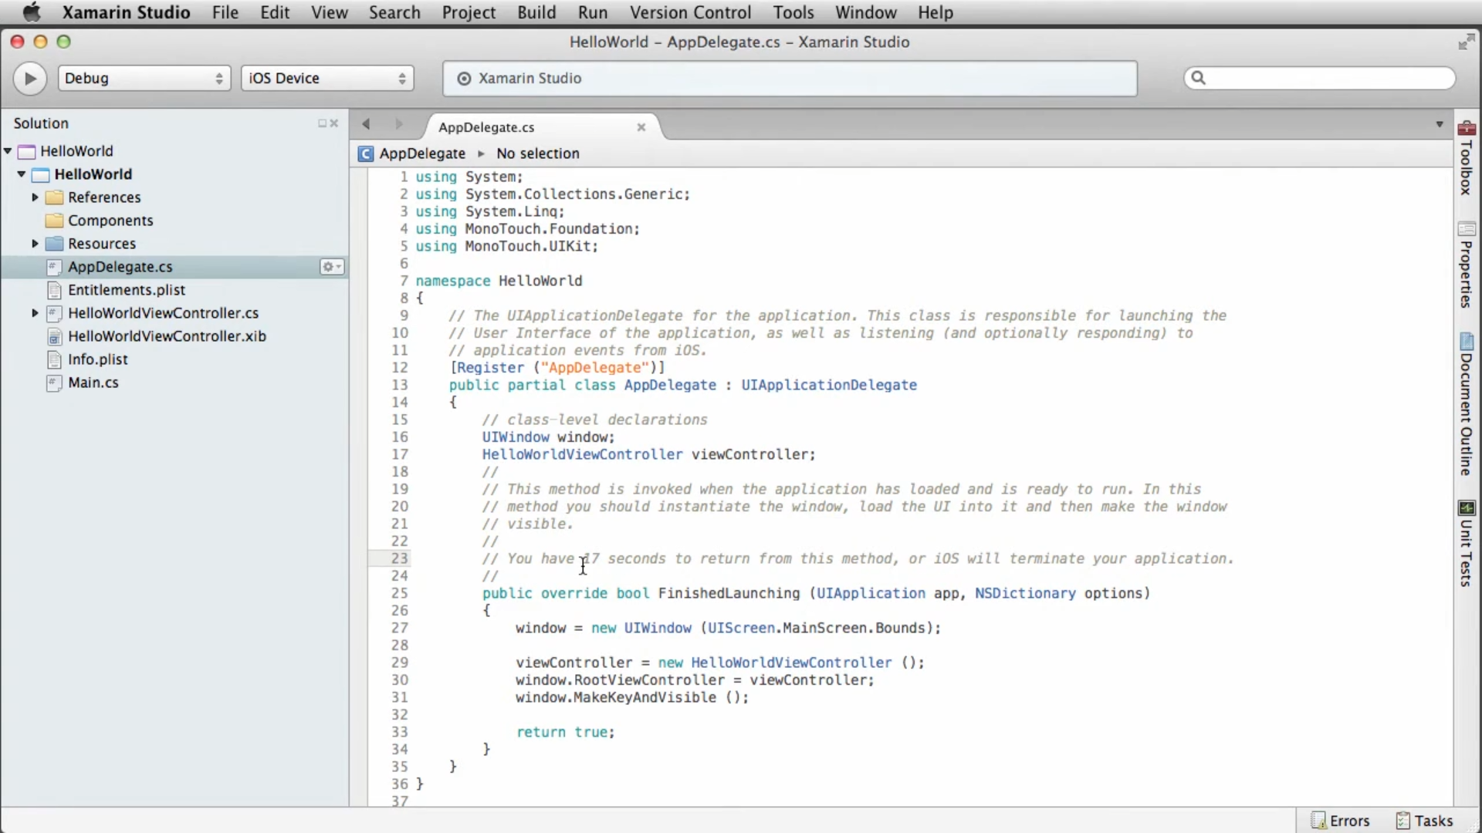
Xamarin Studio

Slide 22
Xamarin Studio
Advantages
Disadvantages
Develop on a Mac
Direct access to iOS Simulator
Lightweight
Not a full IDE
Lack of support for most other .NET workloads and project types

Slide 23
Portable Class Libraries
Advantages
Disadvantages
Share business logic between apps and projects
Cross-platform
Code re-use
Share with non-App projects
Needing to avoid platform specific and .NET version specific gotchas
not for shared UI
replacement: .NET Standard libraries

Slide 24
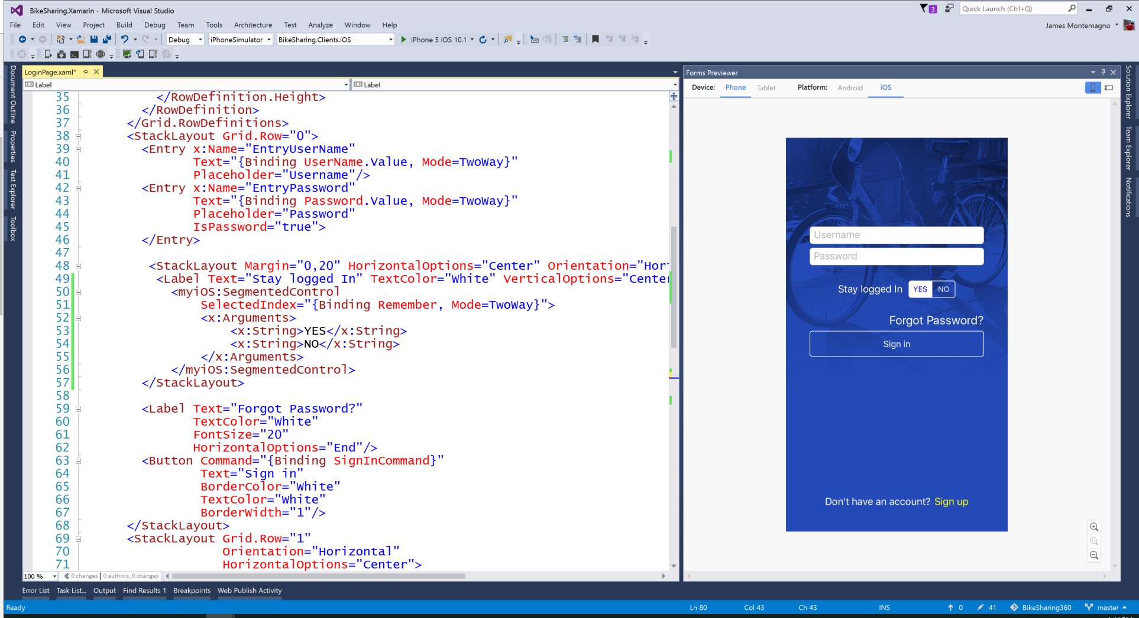
Xamarin.Forms – C# + XAML

Slide 25
2000
2001
2002
2003
2004
2005
2006
2007
2008
2009
2010
2011
2012
2013
2014
2015
2016
2017
2018
2019
2020
2021
2022
2023
2024
2025
Xamarin.Forms
XAML + C#

Slide 26
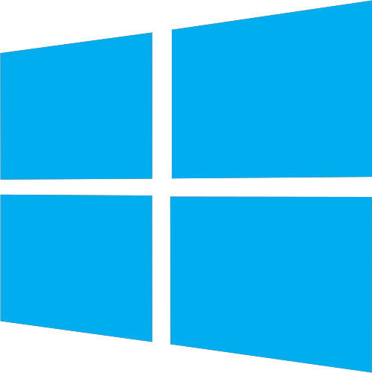



2000
2001
2002
2003
2004
2005
2006
2007
2008
2009
2010
2011
2012
2013
2014
2015
2016
2017
2018
2019
2020
2021
2022
2023
2024
2025
WPF
Silverlight
WinRT
UWP
Xamarin.Forms
XAML + C#
WinUI

Slide 27
Xamarin.Forms
Xamarin
iOS UI
Android UI
Windows UI
Xamarin.Forms XAML UI
Shared C# Logic
Shared C# Logic
Traditional Xamarin approach
With Xamarin.Forms:
More code-sharing, all native

Slide 28
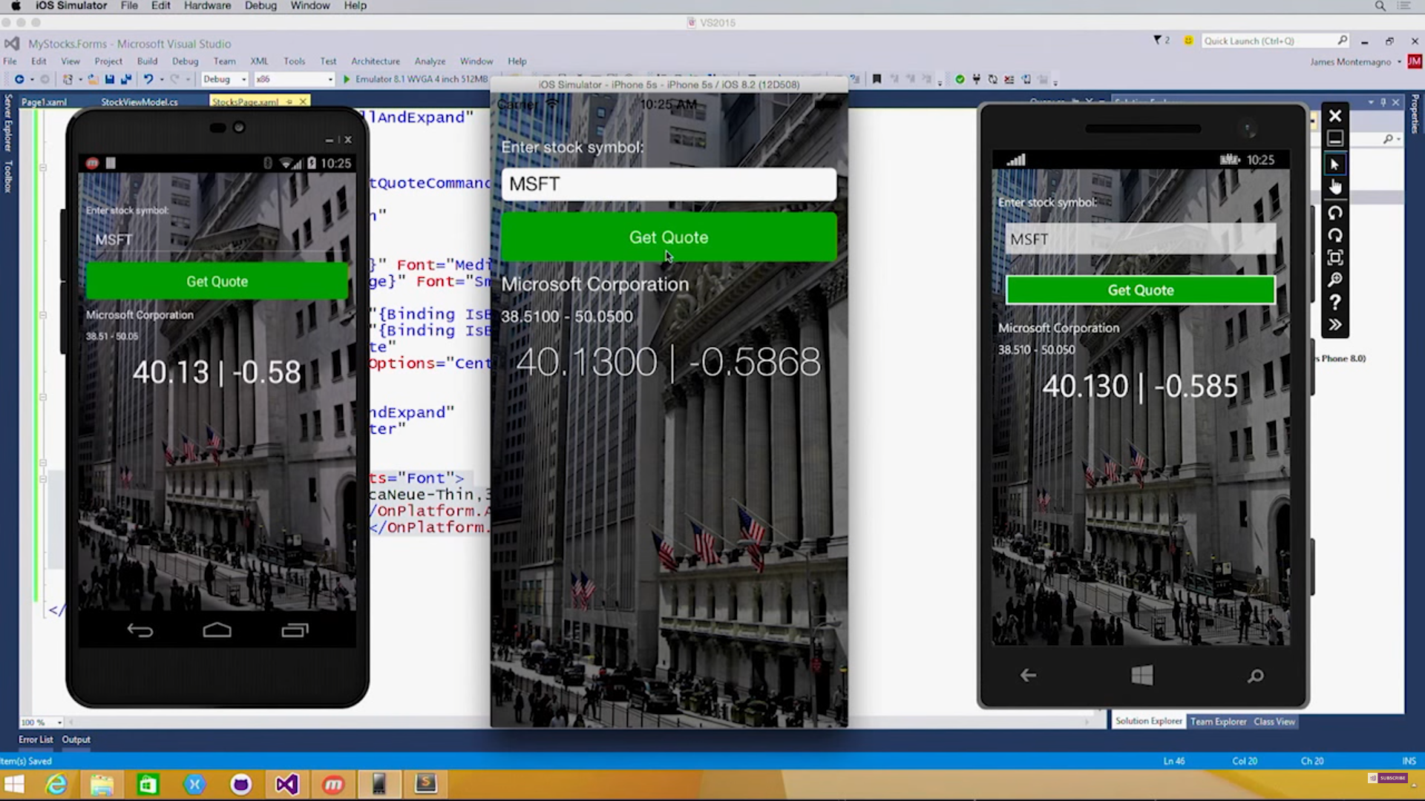
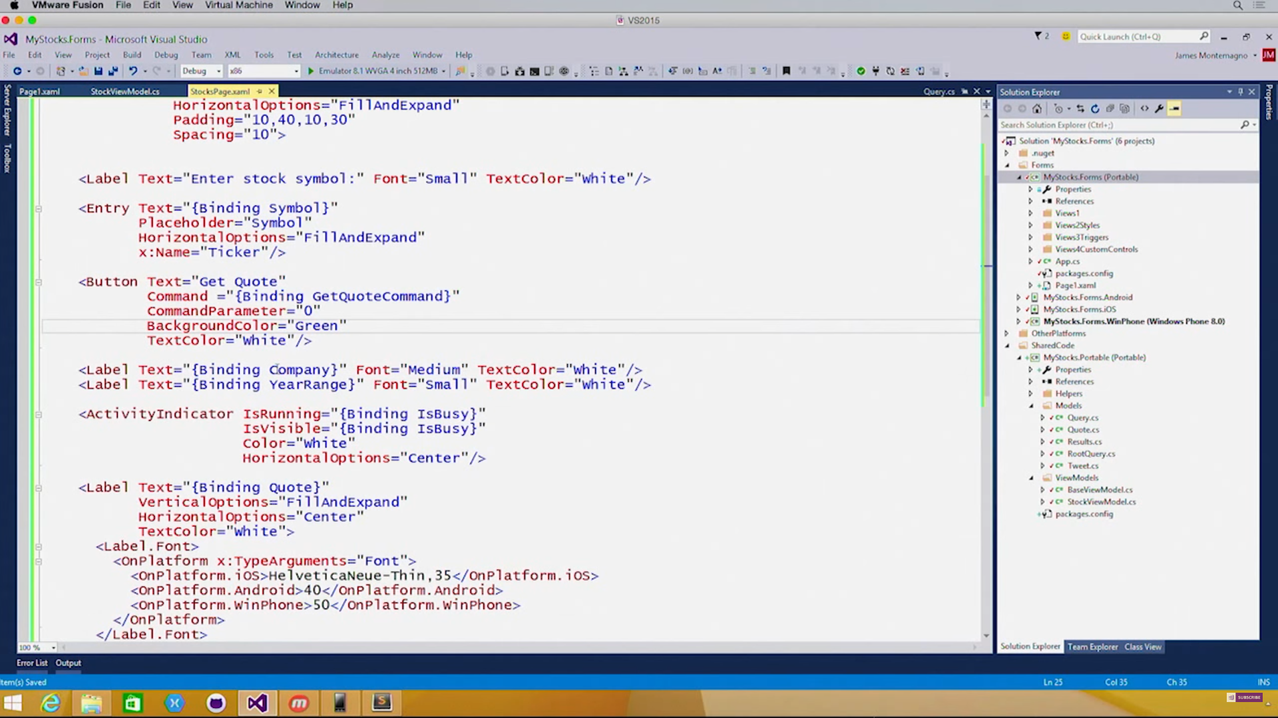
Native UI from XAML

Slide 29
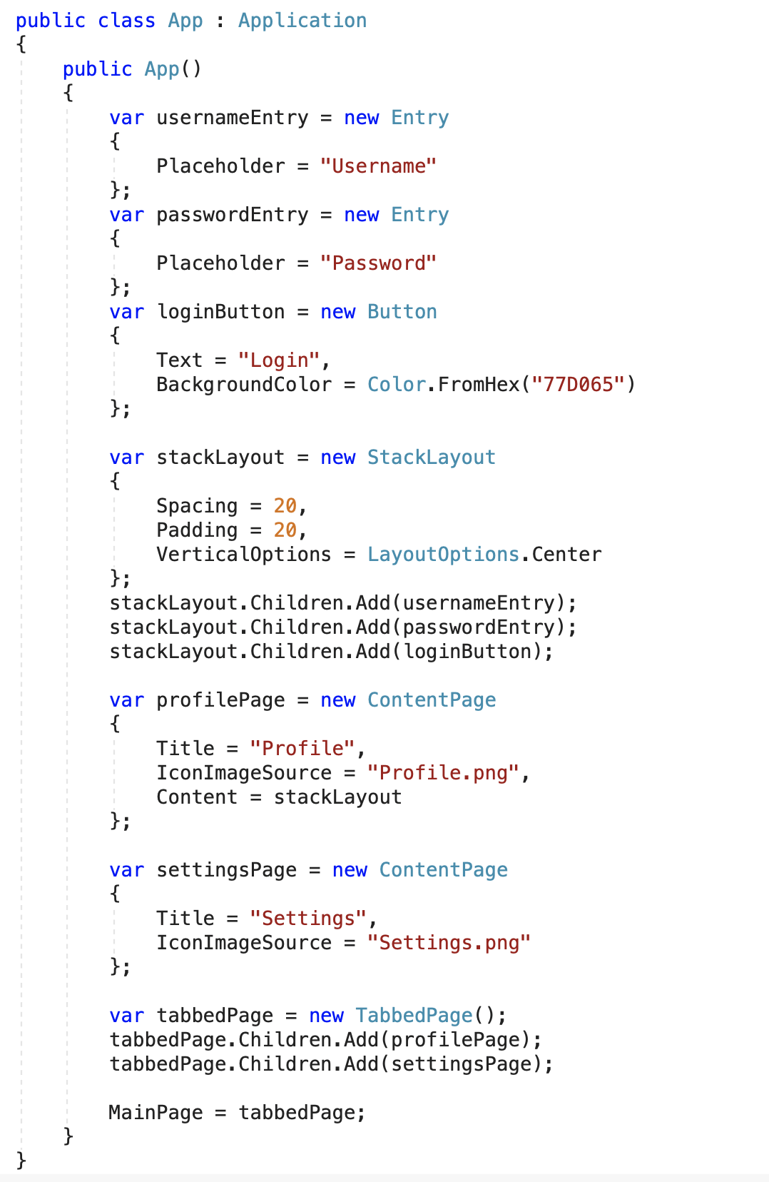
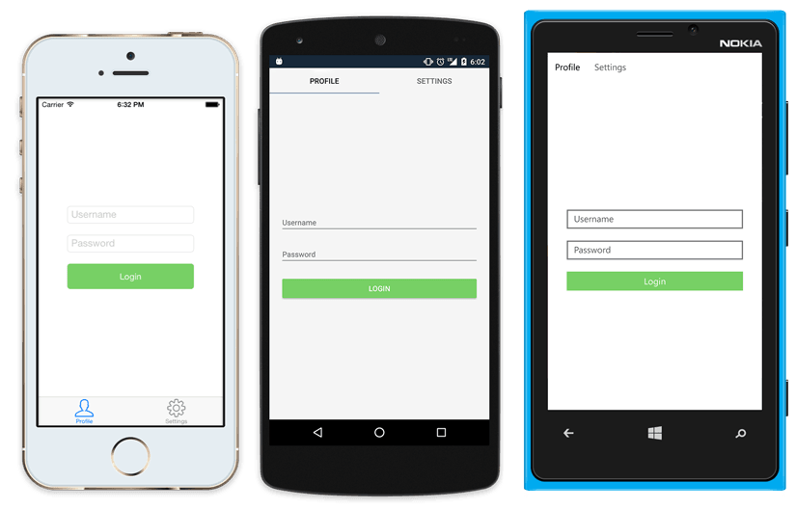
Native UI from shared code
<?xml version="1.0" encoding="UTF-8"?>
<TabbedPage xmlns="http://xamarin.com/schemas/2014/forms"
xmlns:x="http://schemas.microsoft.com/winfx/2009/xaml"
x:Class="MyApp.MainPage">
<TabbedPage.Children>
<ContentPage Title="Profile" Icon="Profile.png">
<StackLayout Spacing="20" Padding="20"
VerticalOptions="Center">
<Entry Placeholder="Username"
Text="{Binding Username}"/>
<Entry Placeholder="Password"
Text="{Binding Password}"
IsPassword="true"/>
<Button Text="Login" TextColor="White"
BackgroundColor="#77D065"
Command="{Binding LoginCommand}"/>
</StackLayout>
</ContentPage>
<ContentPage Title="Settings" Icon="Settings.png">
<!-- Settings -->
</ContentPage>
</TabbedPage.Children>
</TabbedPage>

Slide 30
Xamarin.Forms
Advantages
Disadvantages
Fully Cross-platform, including the UI
XAML Markup
One UI + Codebase = faster
Controls + Extensions
Platform overrides
Difficult to integrate 3rd party libraries
2nd class experience for Windows apps
Hard to debug platform specific issues

Slide 31
2000
2001
2002
2003
2004
2005
2006
2007
2008
2009
2010
2011
2012
2013
2014
2015
2016
2017
2018
2019
2020
2021
2022
2023
2024
2025
Xamarin University
Xamarin Test Cloud
Xamarin.Forms
XAML + C#

Slide 32


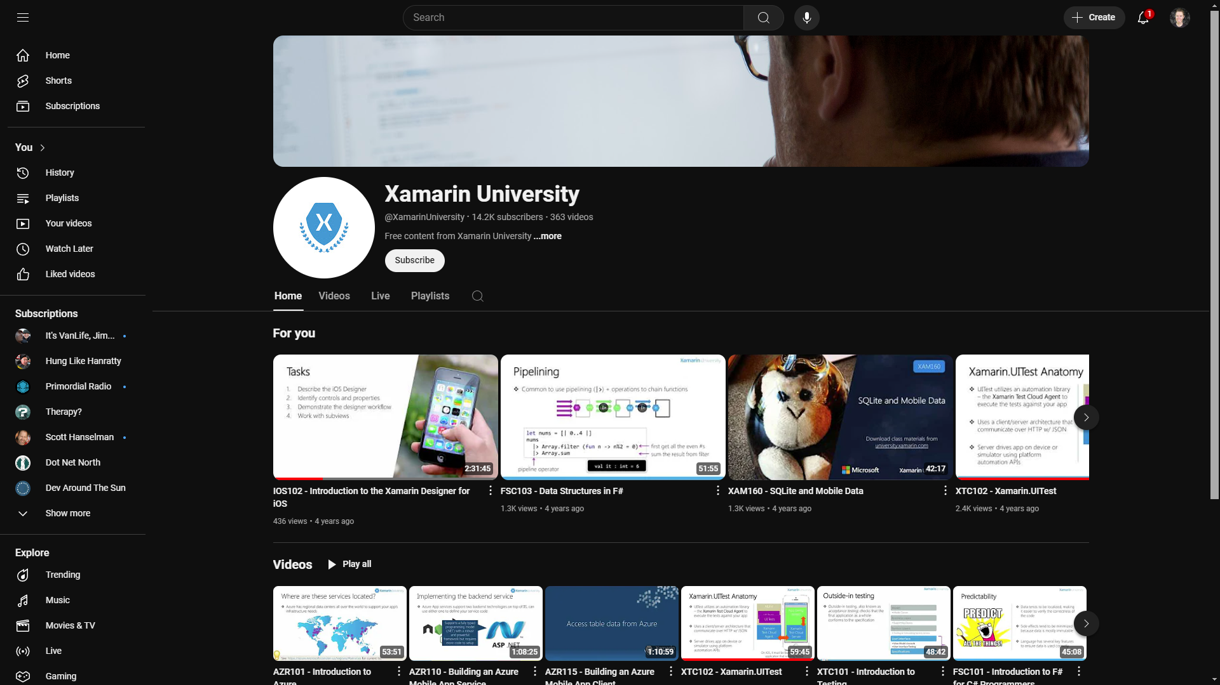
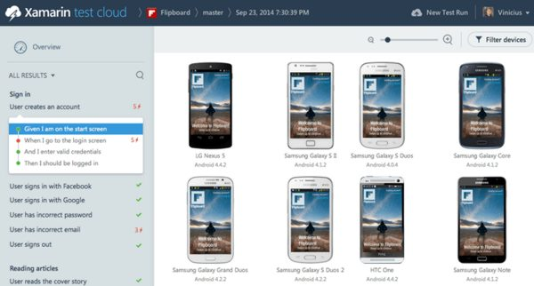
Xamarin Test Cloud
Xamarin University

Slide 33
2000
2001
2002
2003
2004
2005
2006
2007
2008
2009
2010
2011
2012
2013
2014
2015
2016
2017
2018
2019
2020
2021
2022
2023
2024
2025
Xamarin.Forms
XAML + C#

Slide 34

HockeyApp
DevOps
Crash Reporting and Analytics
Builds + App Deployments
Acquired by Microsoft in 2014
Features eventually transitioned into ‘Microsoft App Center’

Slide 35
Xamarin Pricing
Starter – Free
Indie - $299* (or $25/month)
Business - $999*
Enterprise - $1899*
* per developer, per platform, per year!
– on top of Visual Studio / MSDN licensing!

Slide 36

2000
2001
2002
2003
2004
2005
2006
2007
2008
2009
2010
2011
2012
2013
2014
2015
2016
2017
2018
2019
2020
2021
2022
2023
2024
2025

Slide 37
Microsoft acquires Xamarin (2016)
Pricing – made Free!
Focus now on Xamarin.Forms
Xamarin Studio becomes Visual Studio for Mac (vsMac)
Better support added for Windows and Mac Desktop Apps
Samsung add support added for Tizen Apps
HockeyApp becomes Visual Studio App Center

Slide 38
2000
2001
2002
2003
2004
2005
2006
2007
2008
2009
2010
2011
2012
2013
2014
2015
2016
2017
2018
2019
2020
2021
2022
2023
2024
2025
Push
Xamarin Dev Days
iOS Remote Simulator
Xamarin University
Xamarin Test Cloud

Slide 39
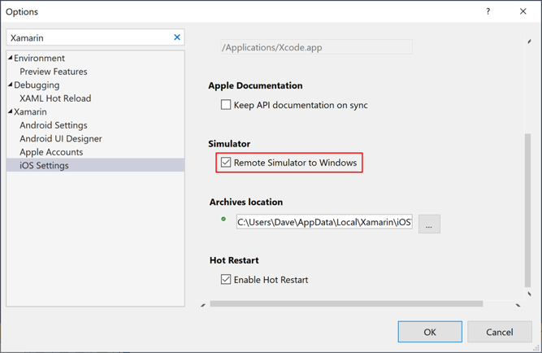
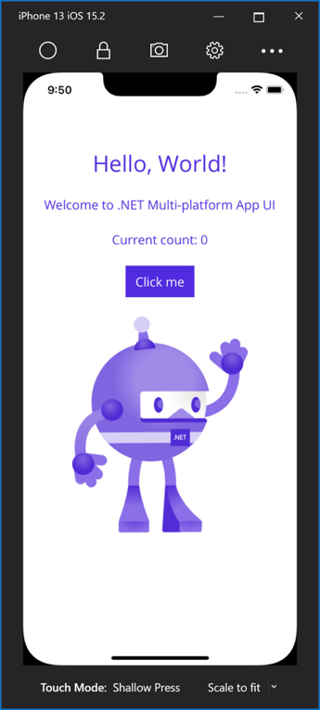
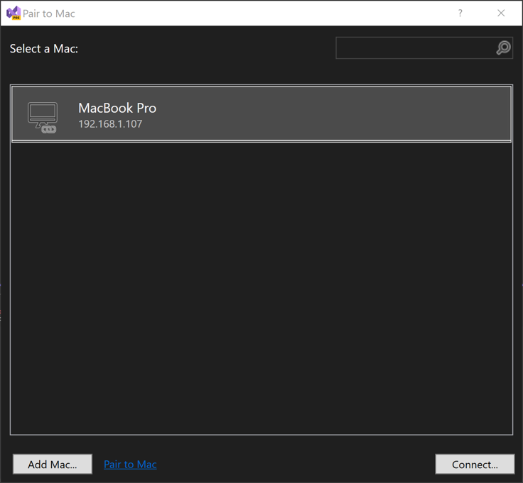
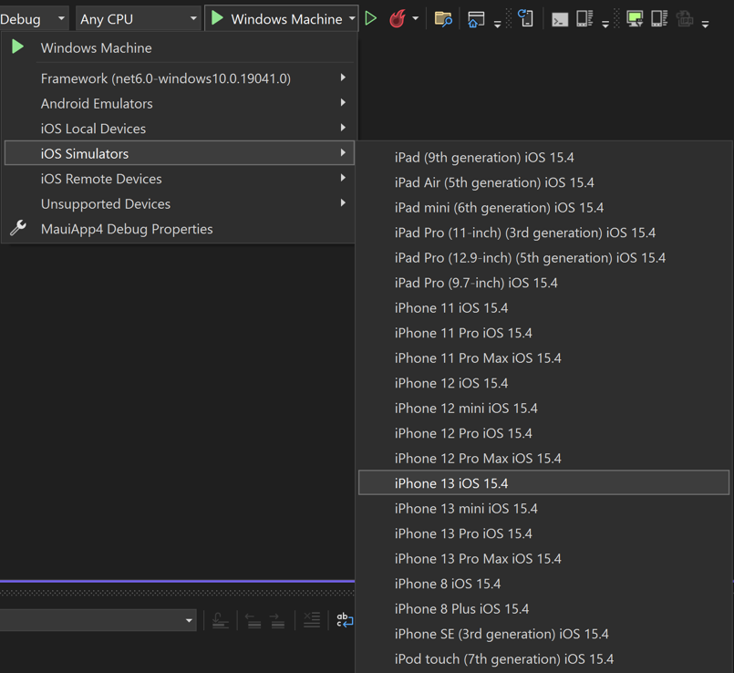
Xamarin iOS Simulator, on Windows

Slide 40


“Xamarin Dev Days” events

Slide 41
.. So what happened next?
.NET Core

Slide 42
2000
2001
2002
2003
2004
2005
2006
2007
2008
2009
2010
2011
2012
2013
2014
2015
2016
2017
2018
2019
2020
2021
2022
2023
2024
2025

Slide 43
2000
2001
2002
2003
2004
2005
2006
2007
2008
2009
2010
2011
2012
2013
2014
2015
2016
2017
2018
2019
2020
2021
2022
2023
2024
2025

Slide 44

2000
2001
2002
2003
2004
2005
2006
2007
2008
2009
2010
2011
2012
2013
2014
2015
2016
2017
2018
2019
2020
2021
2022
2023
2024
2025
.NET 5 - convergence
.NET 6 : .NET MAUI released

Slide 45
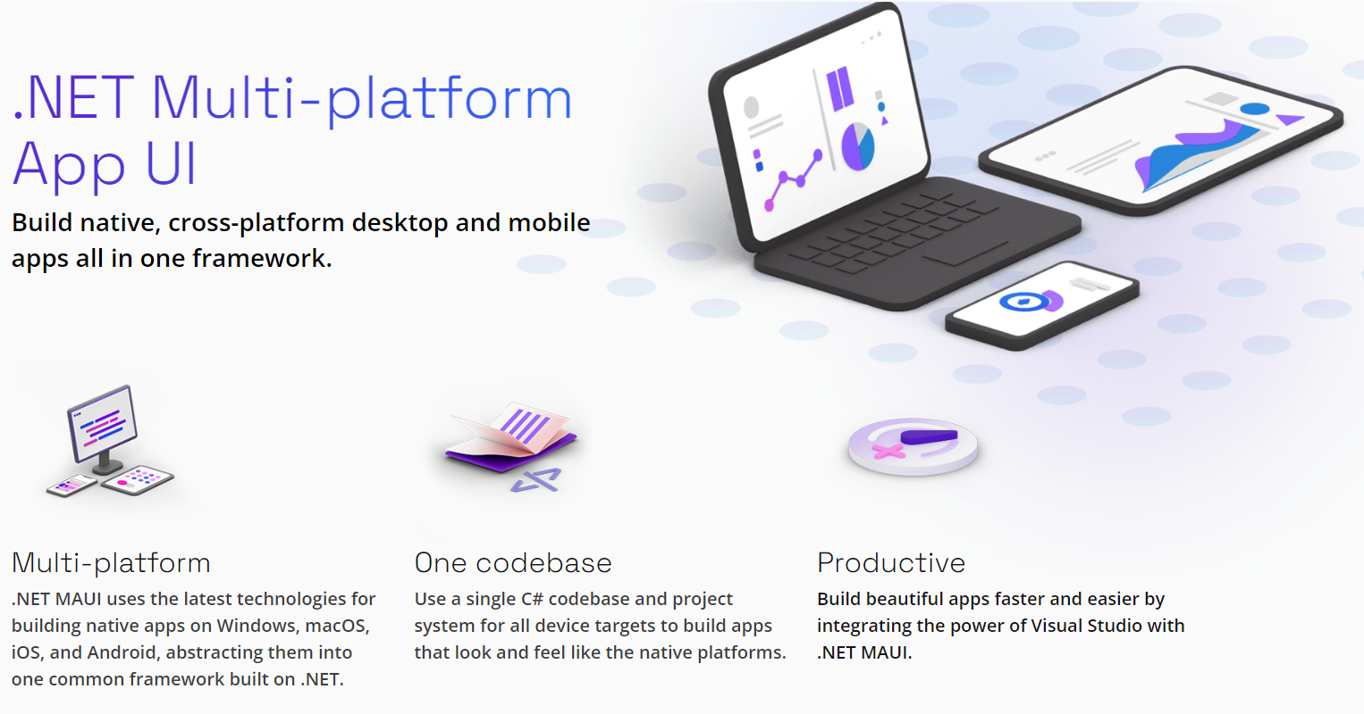

Slide 46
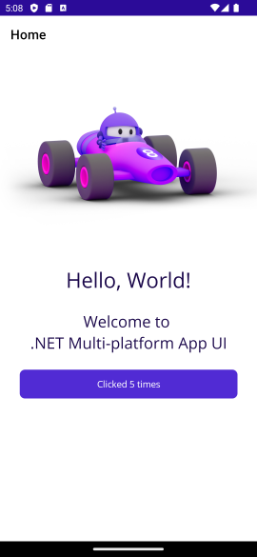
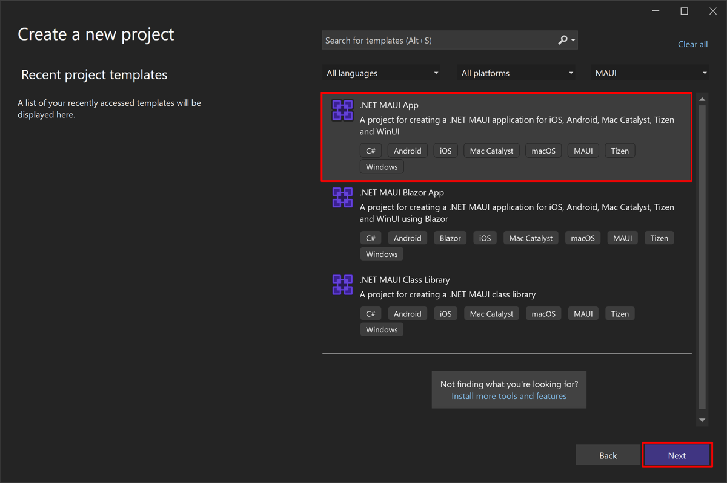
.NET MAUI

Slide 47
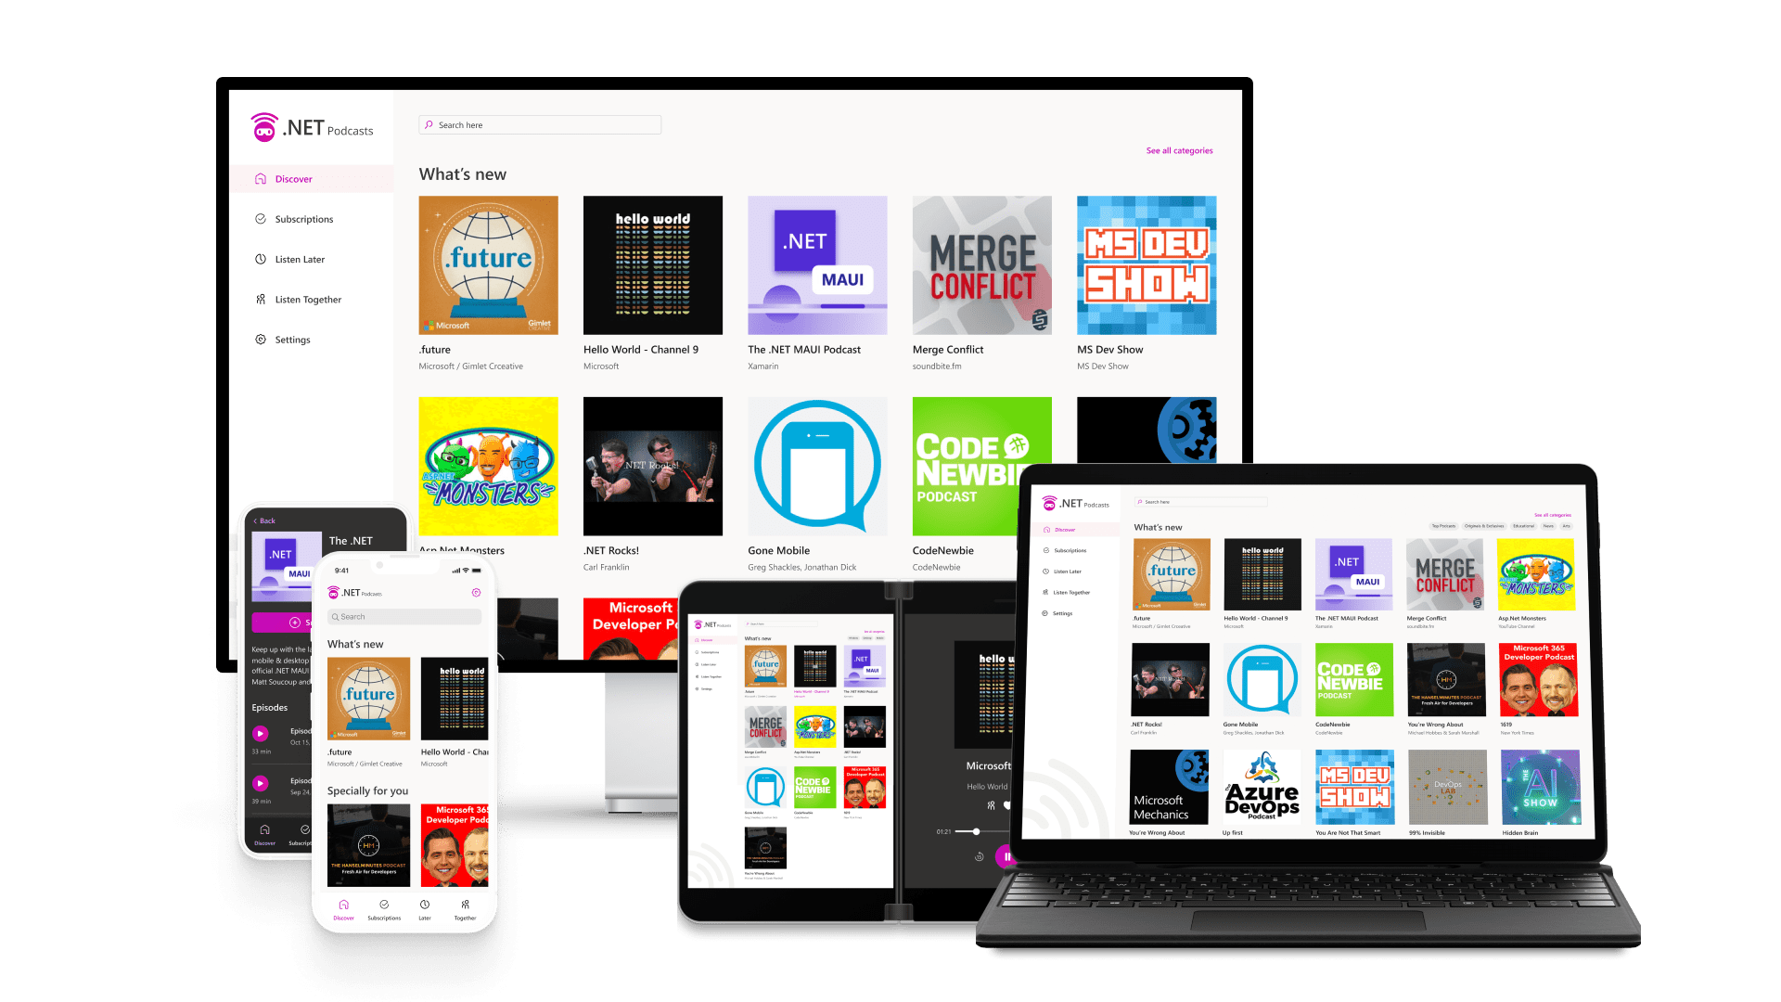
.NET MAUI

Slide 48
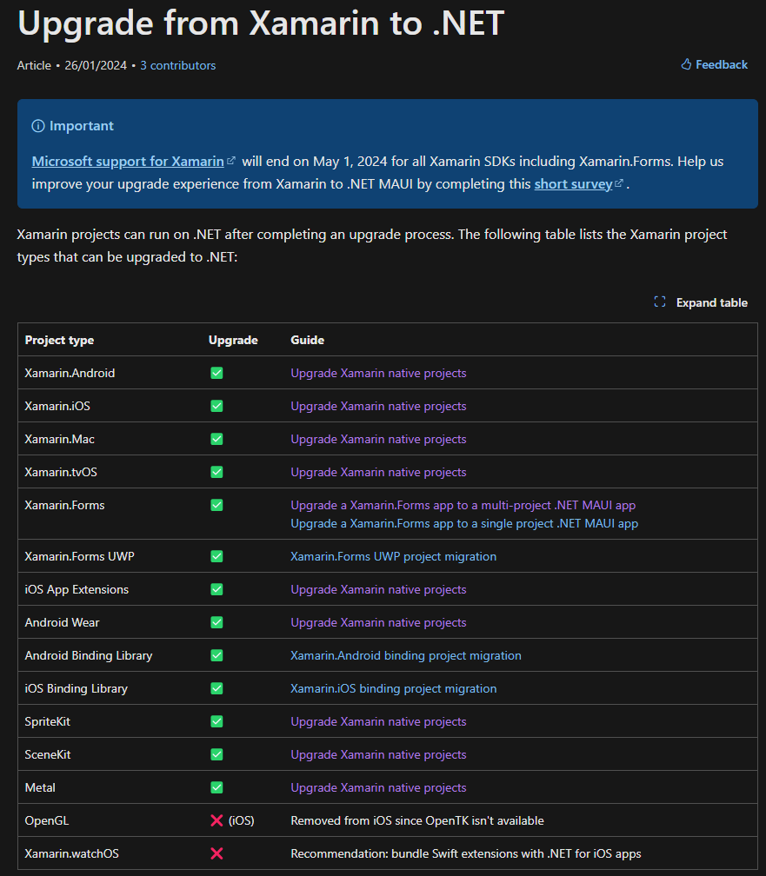
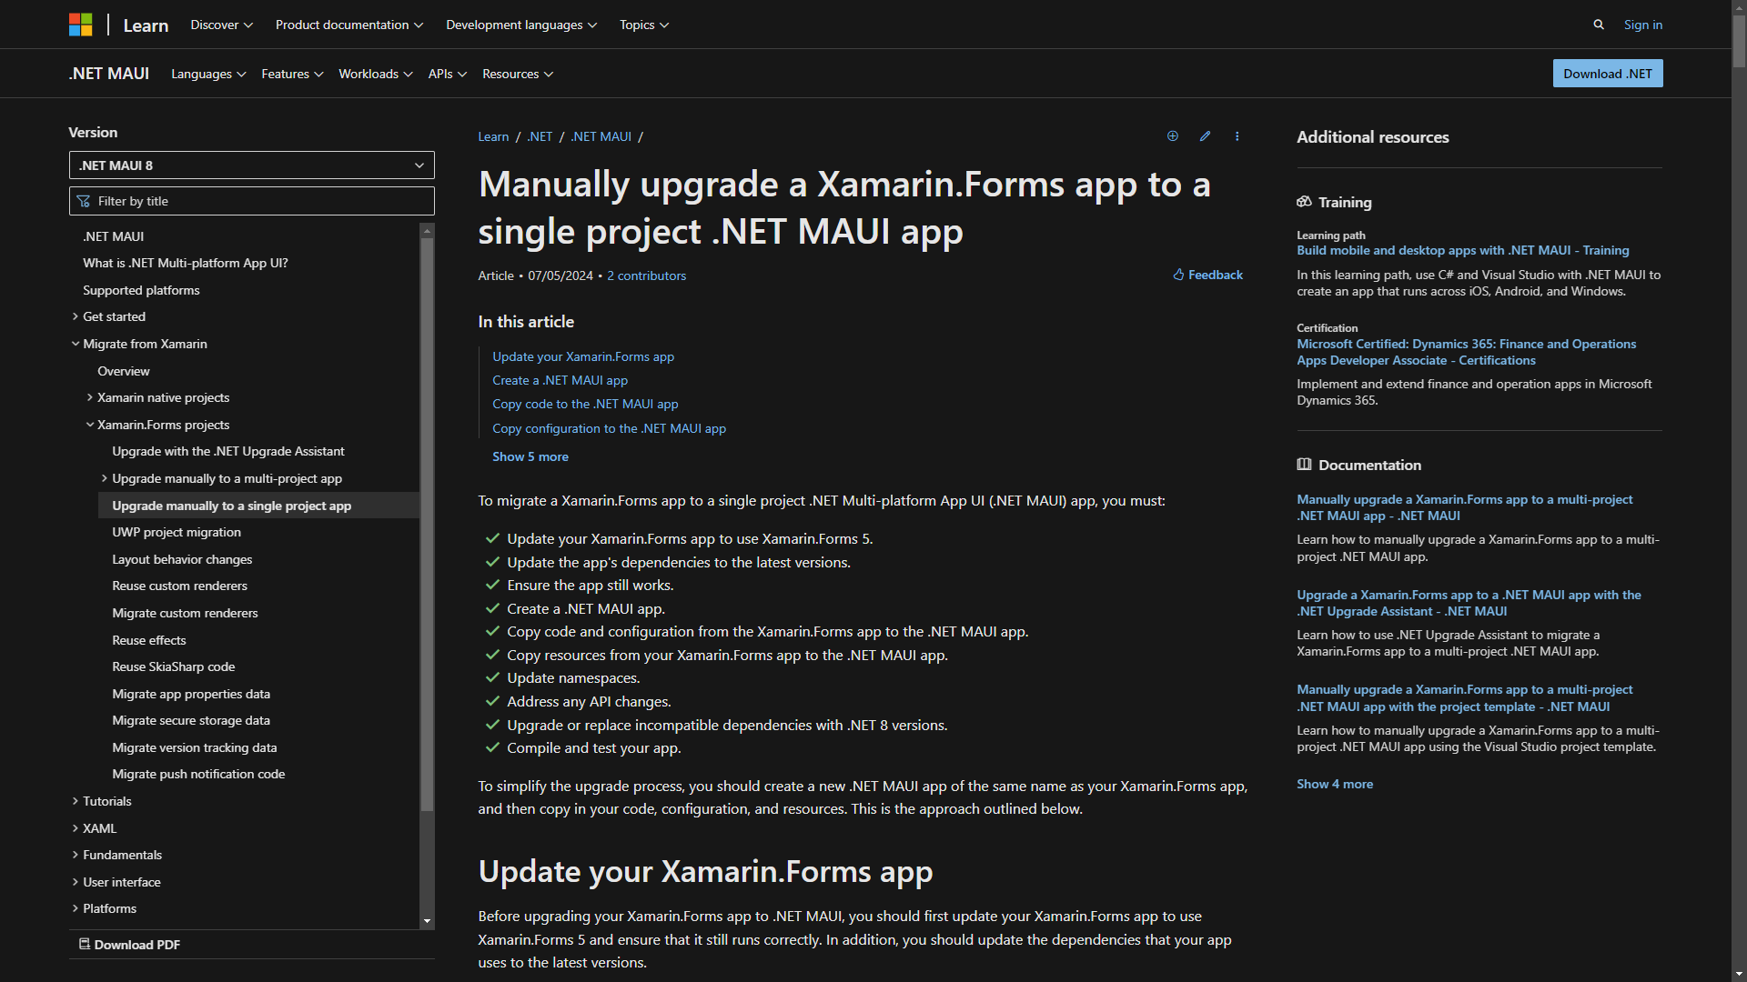
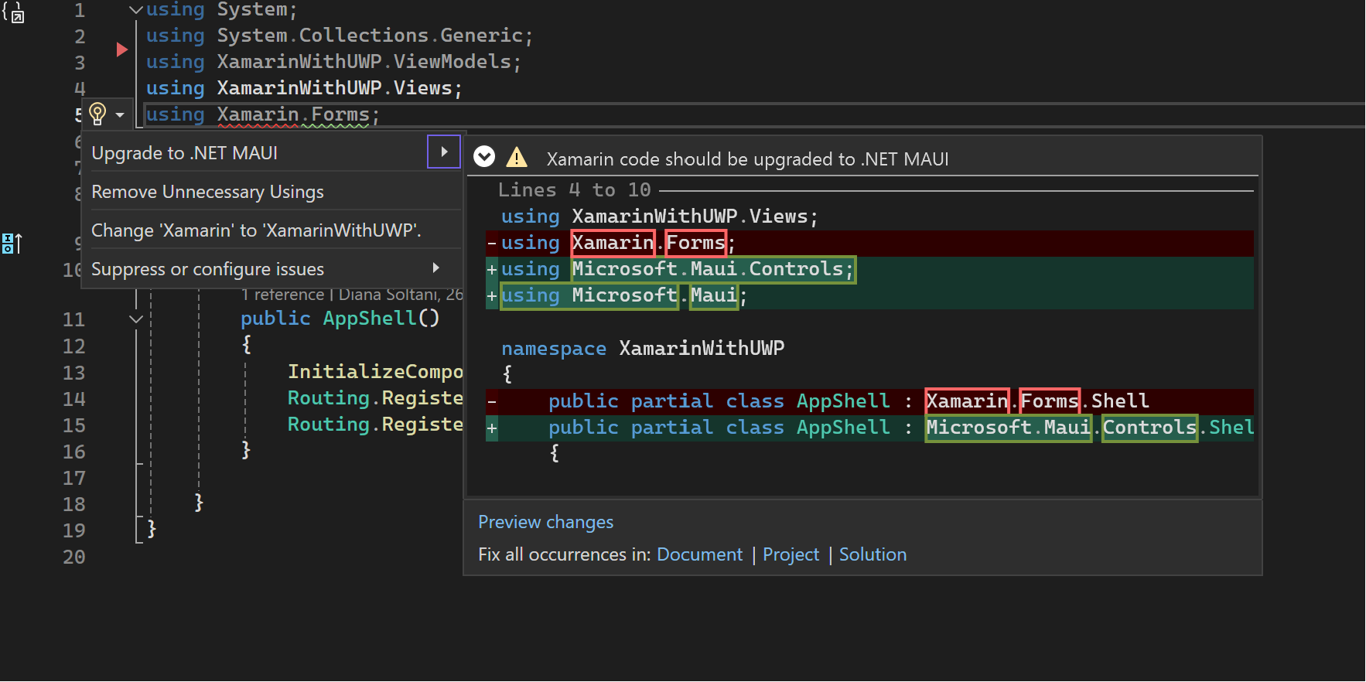
.NET MAUI Upgrade Assistant
https://aka.ms/xamarin-upgrade

Slide 49
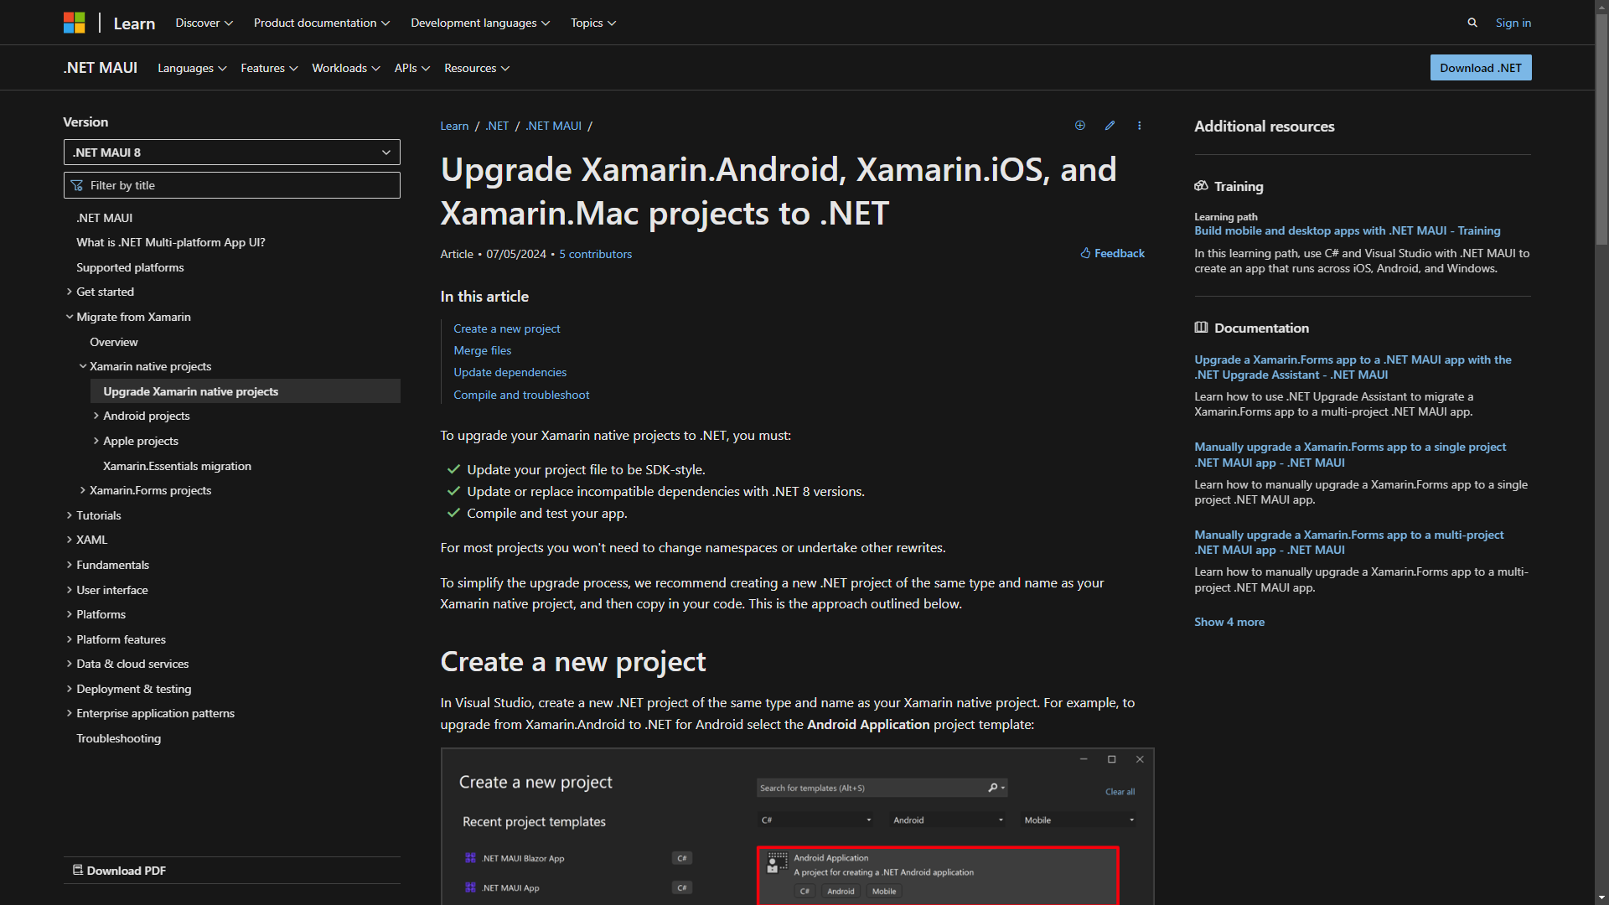
What about Xamarin.Native?
https://aka.ms/xamarin-upgrade

Slide 50
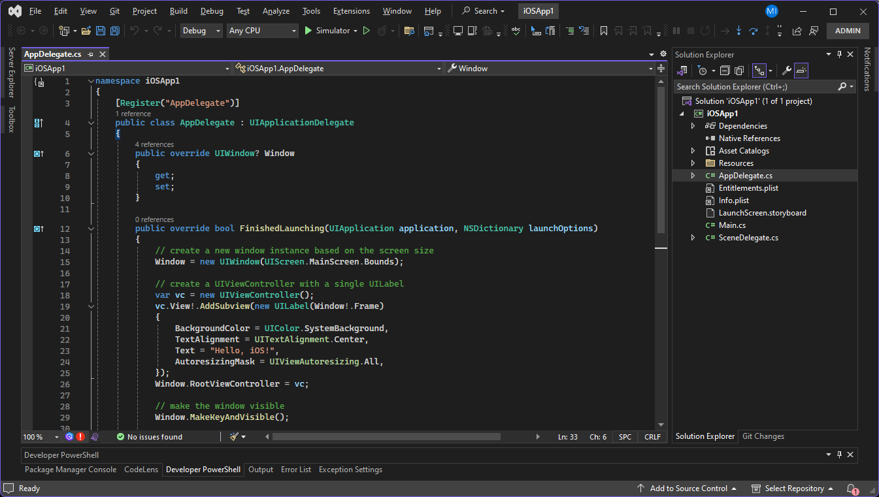


What about Xamarin.Native?

Slide 51
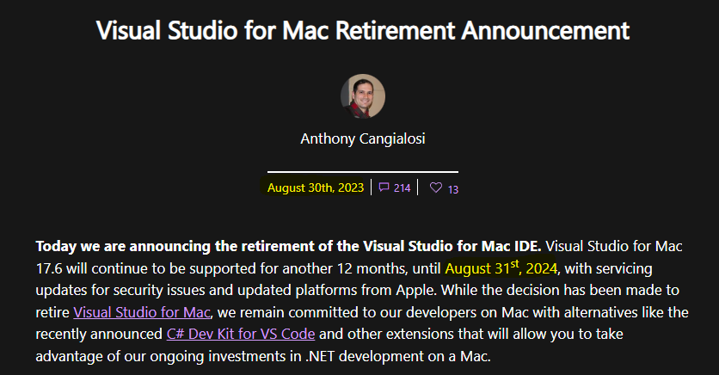


Visual Studio for Mac?

Slide 52
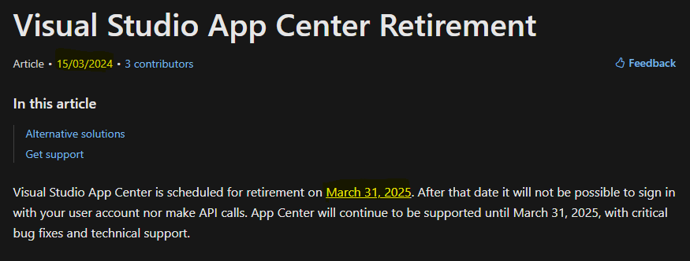


App Center?

Slide 53

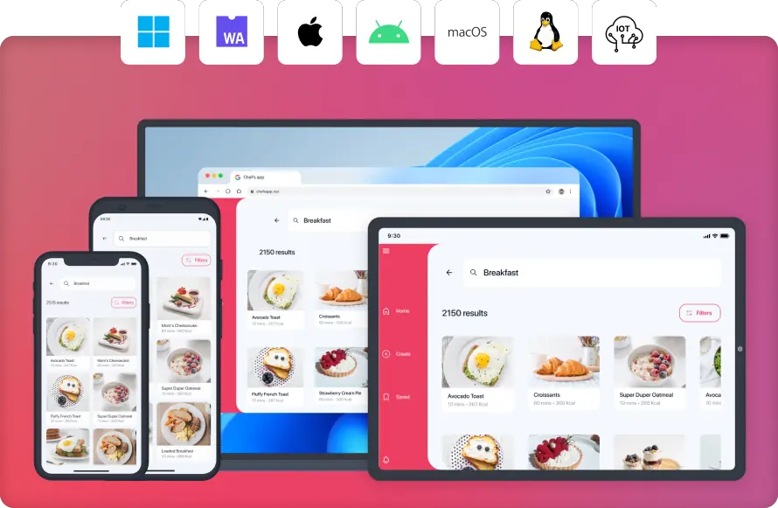
C# Alternatives
C# and XAML
- C# Markup option
- based on WinUI platform
- Native controls
- Mobile, Desktop or Browser
very mature and solid
Figma plugin
No dependency on .NET MAUI or Xamarin
MAUI embedding

Slide 54
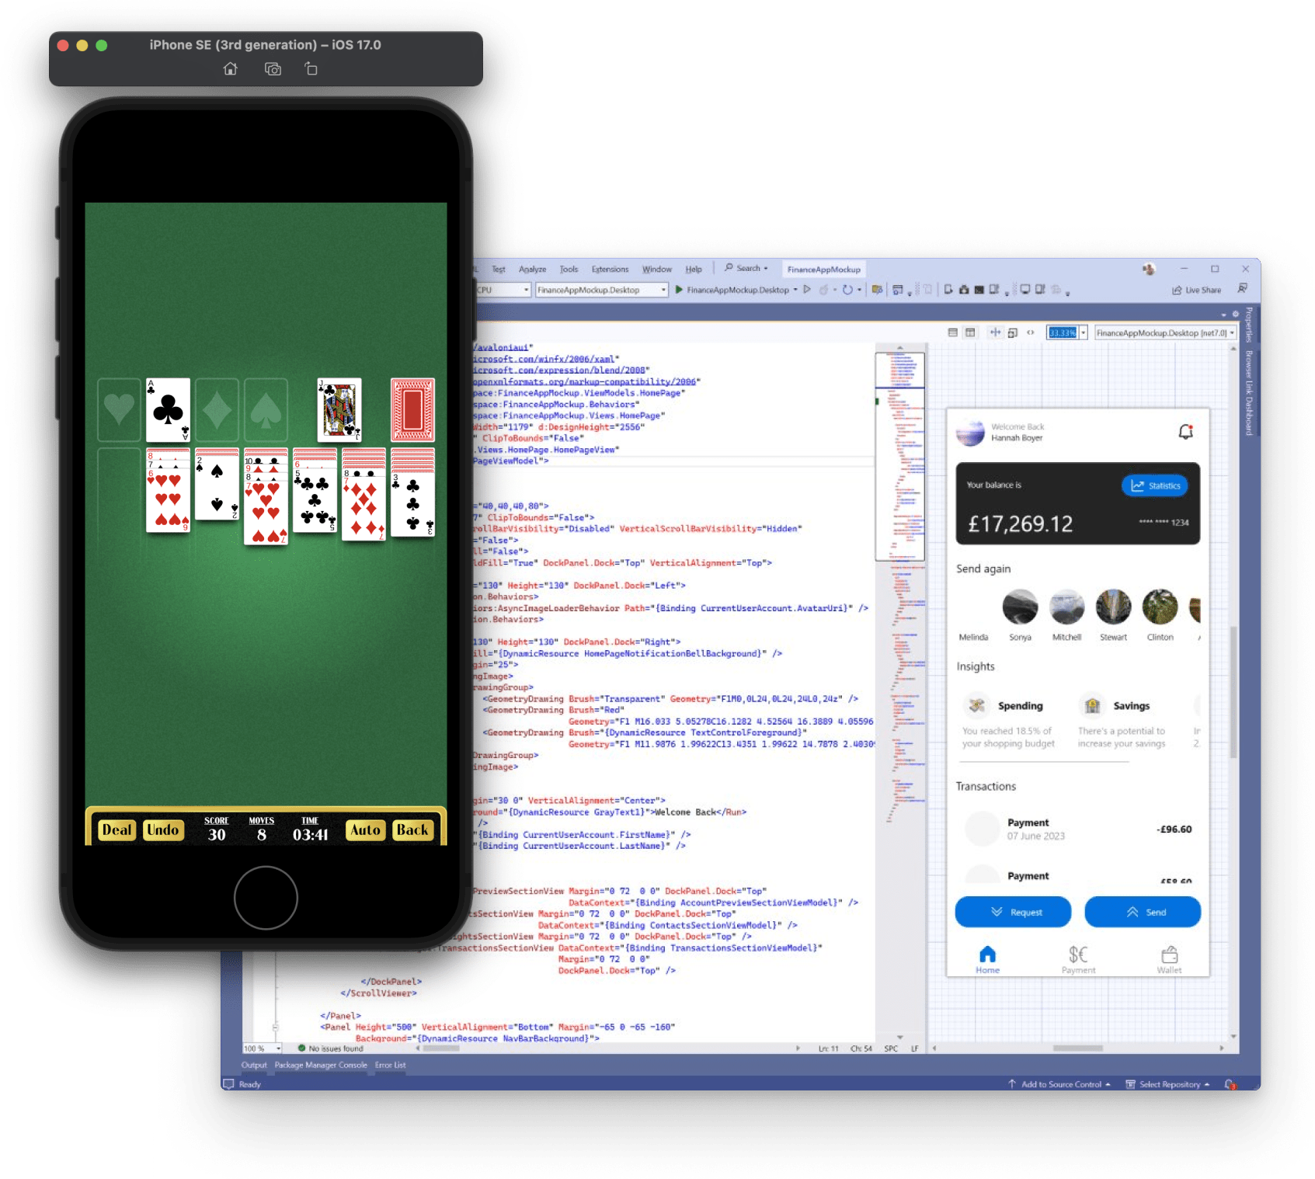

C# Alternatives
C# and XAML
- C# Markup option
- Skia drawn interface
- Mobile, Desktop or Browser
more mature for desktop
XPF – run WPF apps on macOS and Linux
No dependency on .NET MAUI or Xamarin
MAUI embedding

Slide 55


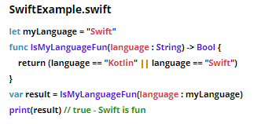
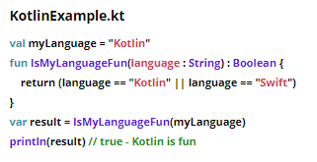
Native
+ Swift UI
+ Jetpack Compose

Slide 56

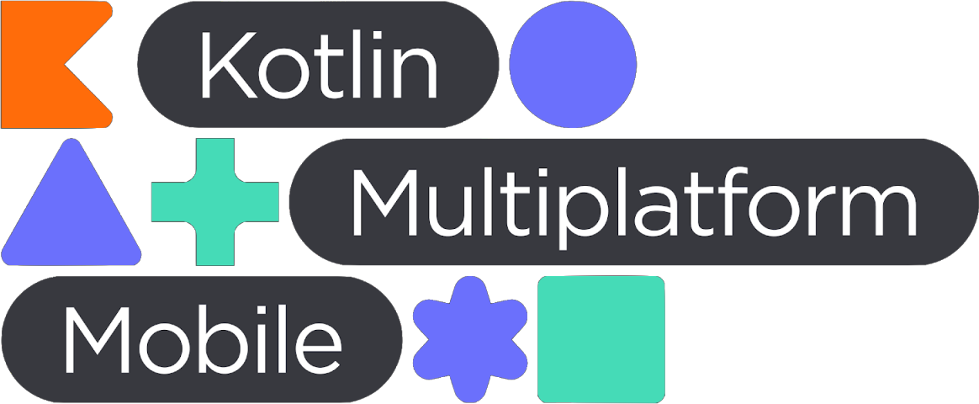

Other Cross-Platform Tools

Slide 57
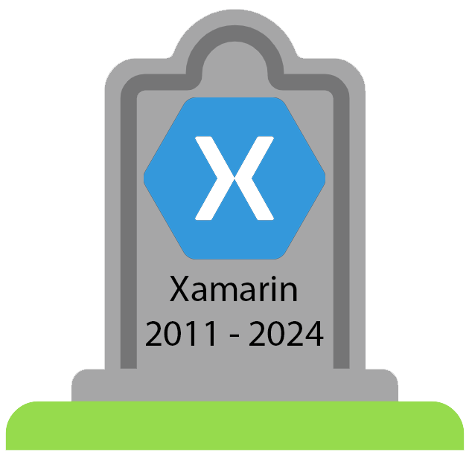
2000
2001
2002
2003
2004
2005
2006
2007
2008
2009
2010
2011
2012
2013
2014
2015
2016
2017
2018
2019
2020
2021
2022
2023
2024
2025
Xamarin – end of life

Slide 58
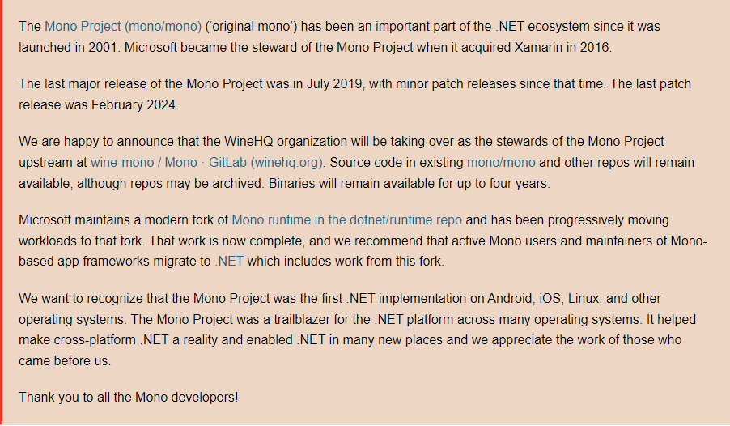

Mono Project donated to Wine
2000
2001
2002
2003
2004
2005
2006
2007
2008
2009
2010
2011
2012
2013
2014
2015
2016
2017
2018
2019
2020
2021
2022
2023
2024
2025
Microsoft donates the Mono Project to the Wine team

Slide 59

Thank you
Slides available on GitHub at github.com/mikeirvingweb/xamarin-moving-on
- All links and references in the README.md file
For more info, find / contact me at:
X / Twitter - twitter.com/mikeirvingweb
LinkedIn - linkedin.com/in/mikeirving
GitHub - github.com/mikeirvingweb
Stack Overflow - stackoverflow.com/users/482901/mike-irving
Website & Blog - mike-irving.co.uk

Slide 60
Xamarin: Moving On
Mike Irving – Microsoft MVP
Senior Developer – Blue Beck
Dot NET Liverpool – 12th November 2024
@mikeirvingweb

